Slide 1
Diagnosing Parkinson’s Disease using Machine Learning
Group 26
Hitarth Panchal (1214537)
Jatin Patel (1229894)
Instructor: Dr. Jinan Fiaidhi

Slide 2
Research Objective
Provide data driven approaches
No blood or lab tests. Clinicians/doctors perform neurological exam and various clinical procedures [1, 2, 3]
Evaluation -> Expertise, Experience, Bias

Slide 3
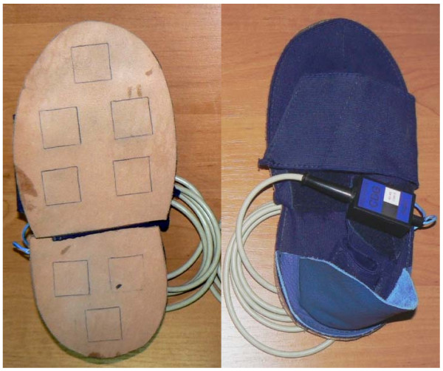
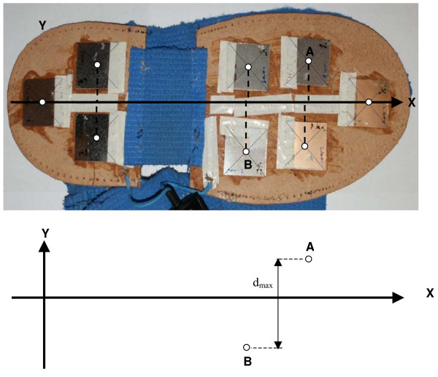
Using Wearable Sensor Data [4, 5, 6, 7]
Computer Dyno Graphy (CDG) system Infotronic [8]

Slide 4
Data Description - Using Wearable Sensor Data
Total 306 data samples
214 PD patients
92 healthy people
Time series data of vertical ground reaction force
Walked on flat surface with normal pace for around 2 minutes
8 sensors for each foot (100 samples/s)
PD or Healthy
Hoehn-Yahr Scale [9]

Slide 5
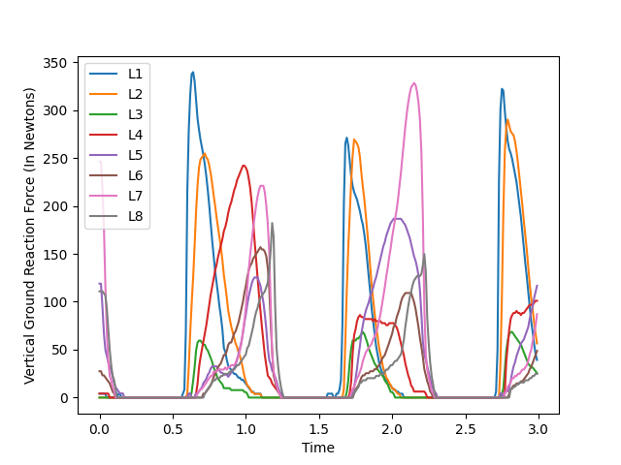
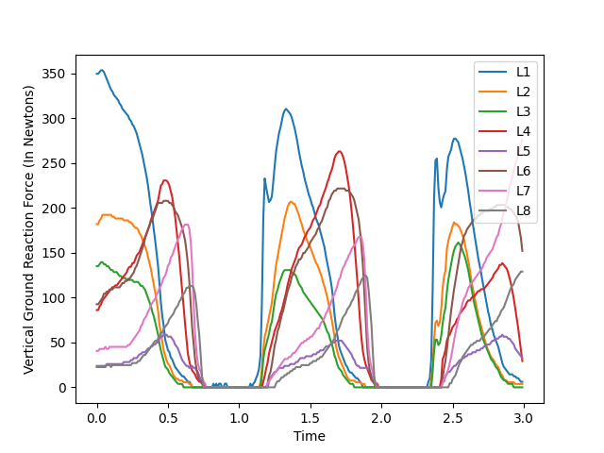
Negative
Positive

Slide 6
Challenges
Solution
Variable Length: ~ 40s to 4m
Curse of Dimensionality: 6.4K to 384K feature values, but only 306 data samples
Missing Labels: >18 % - missing Severity scores leading to severe class imbalance
Binarize the output levels to PD/Healthy

Slide 7
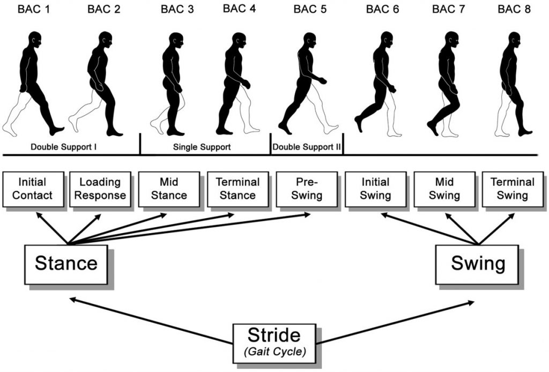
Stride Time & Swing Time
Image Credits [10]

Slide 8
Early detection using Vocal features
The dataset consists of 195 voice recordings of 23 PD patients and 8 healthy individuals.
It has 22 distinct features,
The Traditional ones measured using a sophisticated software called Praat.
Non-Traditional ones measured using some complex Non-linear Mathematical operations like phase space reconstruction, non-linear transformation of the slope of the amplitude variation, etc…

Slide 9
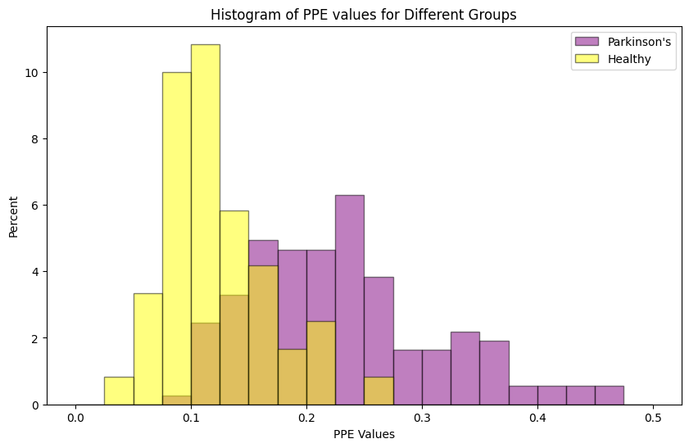
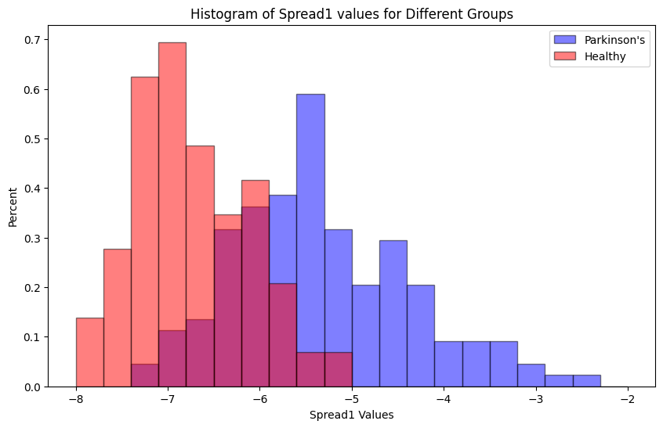
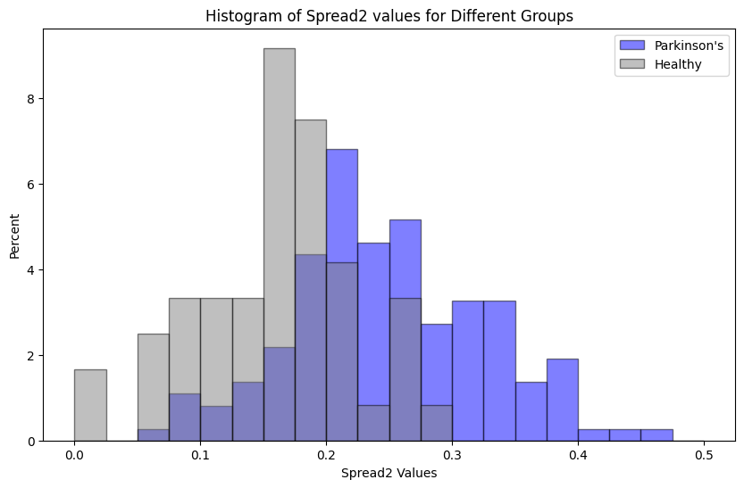
We visualize the distribution of various features. The most significant feature are as shown below:

Slide 10
Two different approaches to “Modelling”
Approach 1:
We use something known as ‘ANOVA’ or ‘Analysis of Variance’ score for feature selection and use the two most significant features, namely- Pitch Period Entropy and the Non-linear Spread of the Fundamental Vocal Frequency.
Approach 2:
Here we use Principal Component Analysis to reduce the number of features to two, and train the model accordingly.

Slide 11
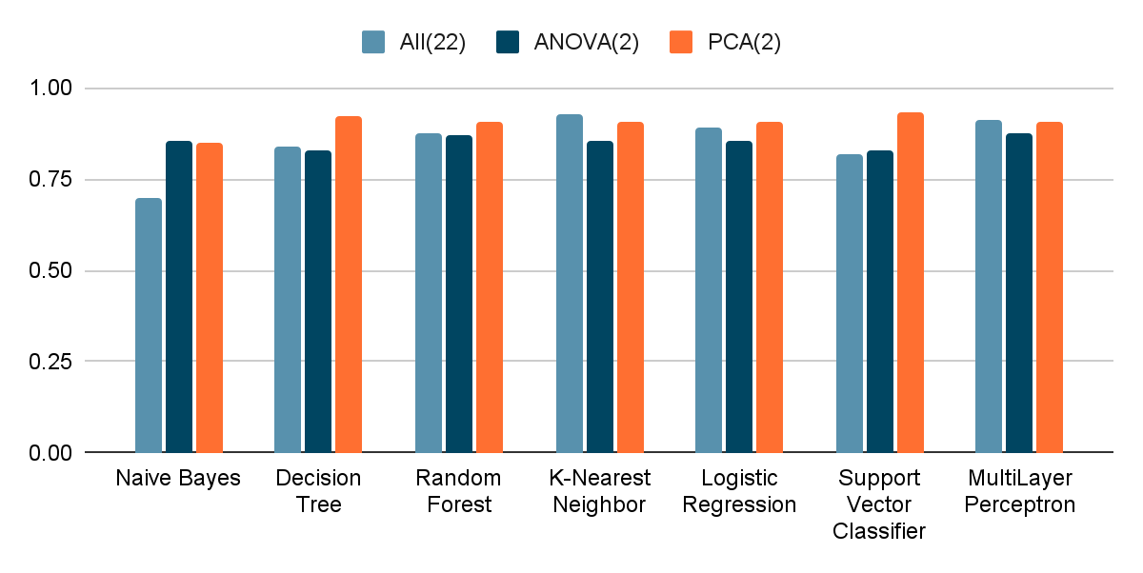

Slide 12
References
“Parkinson’s Disease.” Parkinson’s Disease, American Association of Neurological Surgeons, www.aans.org/en/Patients/Neurosurgical-Conditions-and-Treatments/Parkinsons-Disease.
Khan, Mahreen. “Reporting Rates of Parkinson’s in Canada - Parkinson Canada.” Parkinson Canada, 21 Mar. 2023, www.parkinson.ca/reporting-rates-of-parkinsons-in-canada/#:~:text=From%202019%2D2020%2C%20the%20CCDSS,cases%20of%20Parkinson's%20in%20Canada.
“Parkinson’s Disease: Causes, Symptoms, and Treatments.” National Institute on Aging, U.S. Department of Health and Human Services, Government of United States, 14 Apr. 2022, www.nia.nih.gov/health/parkinsons-disease#:~:text=Parkinson’s%20disease%20is%20a%20brain,have%20difficulty%20walking%20and%20talking.
Frenkel-Toledo S, Giladi N, Peretz C, Herman T, Gruendlinger L, Hausdorff JM. Effect of gait speed on gait rhythmicity in Parkinson's disease: variability of stride time and swing time respond differently. Journal of NeuroEngineering and Rehabilitation 2005: 2:23.
Frenkel-Toledo, S, Giladi N, Peretz C, Herman T, Gruendlinger L, Hausdorff JM. Treadmill walking as a pacemaker to improve gait rhythm and stability in Parkinson's disease. Movement Disorders 2005; 20(9):1109-1114.

Slide 13
References
Hausdorff JM, Lowenthal J, Herman T, Gruendlinger L, Peretz C, Giladi N. Rhythmic auditory stimulation modulates gait variability in Parkinson's disease Eur J Neuroscience 2007; 26: 2369-2375.
Yogev G, Giladi N, Peretz C, Springer S, Simon ES, Hausdorff JM. Dual tasking, gait rhythmicity, and Parkinson's disease: Which aspects of gait are attention demanding? Eur J Neuroscience 2005; 22:1248-1256.
Jeleń, Piotr, et al. “Expressing Gait-line Symmetry in Able-bodied Gait.” Dynamic Medicine, vol. 7, no. 1, BioMed Central, Dec. 2008, https://doi.org/10.1186/1476-5918-7-17.
“Hoehn and Yahr Scale.” Physiopedia, www.physio-pedia.com/Hoehn_and_Yahr_Scale.
Stöckel, Tino & Jacksteit, Robert & Behrens, Martin & Skripitz, Ralf & Bader, Rainer & Mau-Moeller, Anett. (2015). The mental representation of the human gait in young and older adults. Frontiers in Psychology. 6. 943. 10.3389/fpsyg.2015.00943.

Slide 14
Thank You

